Slide 1
Lattice Imperfections and Off-momentum Particles
Eric Prebys, FNAL

Slide 2
Lattice Imperfections
Up until now, we have considered an ideal lattice, but real magnets aren’t perfect.
We will consider two types of lattice imperfections:
Dipole errors
Quadrupole errors
We will also discuss how to locally correct the position of the beam.

Slide 3
Closed Orbit Distortion (“cusp”)
We place a dipole at one point in a ring which bends the beam by an amount Θ.
The new equilibrium orbit will be defined by a trajectory which goes once around the ring, through the dipole, and then returns to its exact initial conditions. That is
Recall that we can express the transfer matrix for a complete revolution as

Slide 4
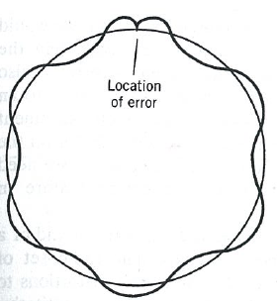
Plug this back in
We now propagate this around the ring

Slide 5
Quadrupole Errors
We can express the matrix for a complete revolution at a point as
If we add focusing quad at this point, we have
We calculate the trace to find the new tune
For small errors

Slide 6
Total Tune Shift
The focal length associated with a local anomalous gradient is
So the total tune shift is

Slide 7
Local Correction
Recall our generic transfer matrix
If we use a dipole to introduce a small bend Θ at one point, it will in general propagate as
Remember this one forever

Slide 8
“Three Bump”
Consider a particle going down a beam line. By using a combination of three magnets, we can localize the beam motion to one area of the line
We require
Local Bumps are an extremely powerful tool in beam tuning!!
Cancel out angle from first two bends

Slide 9
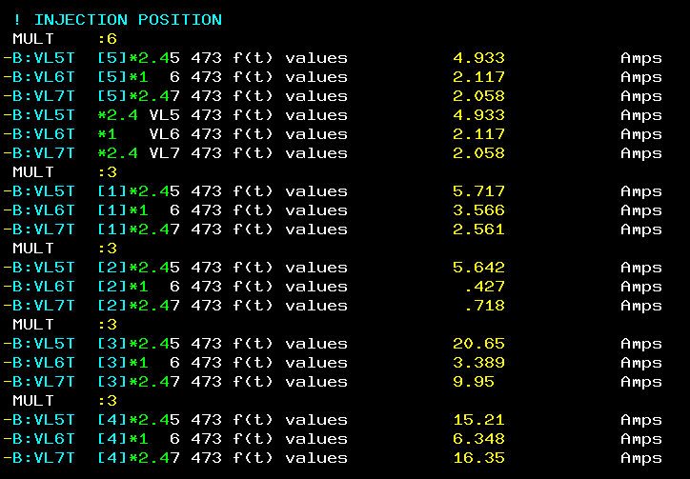
Controls Example
From Fermilab “Acnet” control system
The B:xxxx labels indicate individual trim magnet power supplies in the Fermilab Booster
Defining a “MULT: N” will group the N following magnet power supplies
Placing the mouse over them and turning a knob on the control panel will increment the individual currents according to the ratios shown in green

Slide 10
Off-Momentum Particles
Our previous discussion implicitly assumed that all particles were at the same momentum
Each quad has a constant focal length
There is a single nominal trajectory
In practice, this is never true. Particles will have a distribution about the nominal momentum
We will characterize the behavior of off-momentum particles in the following ways
“Dispersion” (D): the dependence of position on deviations from the nominal momentum
D has units of length
“Chromaticity” (η) : the change in the tune caused by the different focal lengths for off-momentum particles
Path length changes (momentum compaction)

Slide 11
Equations of Motion (redoing the steps we skipped)
General equation of motion
For the moment, we will consider motion in the horizontal (x) plane, with a reference trajectory established by the dipole fields.
Solving in this coordinate system, we have
Particle trajectory
Reference trajectory

Slide 12
Equations of Motion (cont’d)
Equating the x terms
Re-express in terms of path length s. Use
Rewrite equation
Note: s measured along nominal trajectory, v_{s} measured along actual trajectory

Slide 13
Treating off-momentum Particle Motion
To treat off-momentum particles, we start with our original these original equations of motion.
The rigidity shown is for the nominal momentum, but I can correct the equation for the true momentum by substituting the “true” rigidity
If we substitute that into the equation, and keep only the lowest order terms, we have
If we then also keep only the lowest order terms in the fields, we have
If we take only the first order terms in the rest of the equation, as we did before, the only change is that extra term on the RHS.

Slide 14
This is a second order differential inhomogeneous differential equation, so the solution is
Where d(s) is the solution particular solution of the differential equation
We solve this piecewise, for K constant and find
Recall

Slide 15
Matrix Representation
I have the solution
We can express this in matrix form as
Solution to the on-momentum case
Off-momentum correction
Usual transfer matrix

Slide 16
Example: FODO Cell
We look at our symmetric FODO cell, but assume that the drifts are bend magnets
For a thin lens d~d’~0. For a pure bend magnet
Leading to the transfer Matrix
L
L
2f
-f
2f

Slide 17
Solving for Equilibrium Orbit
We hypothesize that we will have a new equilibrium reference orbit for off-momentum particles, defined as a function of position by
We expect this to have the periodicity of the lattice, so in general
“Dispersion”
Can set δ to 1

Slide 18
Solving for Dispersion
Going back to our original FODO cell (with bends)
We must solve

Slide 19
Solving for Lattice Functions
We have already solved for the basic lattice functions
You’ll solve in the homework
It will really simplify things if you invoke symmetry to show that

Slide 20
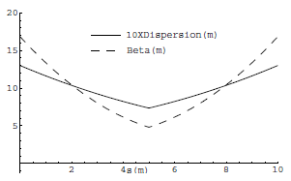
Evolution of Dispersion Functions
Since the dispersion functions represent displacements, they will evolve like the position
Putting it all together

Slide 21
Momentum Compaction and Slip Factor
In general, particles with a high momentum will travel a longer path length. We have
The slip factor is defined as the fractional change in the orbital period
Note that
“momentum compaction”

Slide 22
Transition γ
In homework, you showed that for a simple FODO CELL
If we assume they vary ~linearly between maxima, then for small μ
It follows
This approximation generally works better than it should

Slide 23
Chromaticity
In general, momentum changes will lead to a tune shift by changing the effective focal lengths of the magnets
As we are passing trough a magnet, we can find the focal length as
But remember that our general equation of motion is
Clearly, a change in momentum will have the same effect on the entire focusing term, so we can write in general
This can be expressed in terms of lattice functions (after a lot of messy algebra) as

Slide 24
Chromaticity and Sextupoles
we can write the field of a sextupole magnet as
If we put a sextupole in a dispersive region then off momentum particles will see a gradient which is effectively like a position dependent quadrupole, with a focal length given by
So we write down the tune-shift as
Note, this is only valid when the motion due to momentum is large compared to the particle spread (homework problem)
p=p₀+Δp
Nominal momentum

